Slide 1
Looking Forward
- The Latest Trends in Logistics
Hong Kong, November 6th 2013
Martin Holme, Chief Operating Officer, North Asia

Slide 2



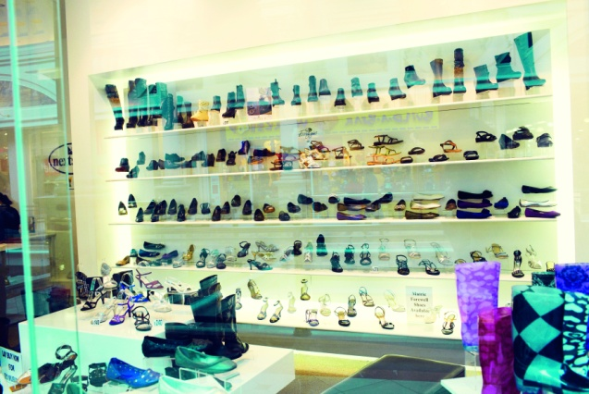
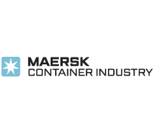
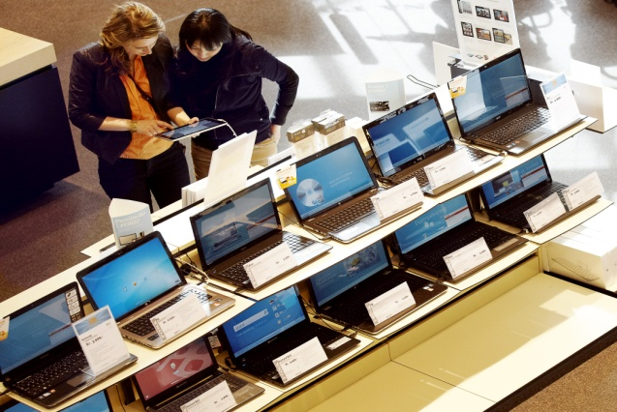

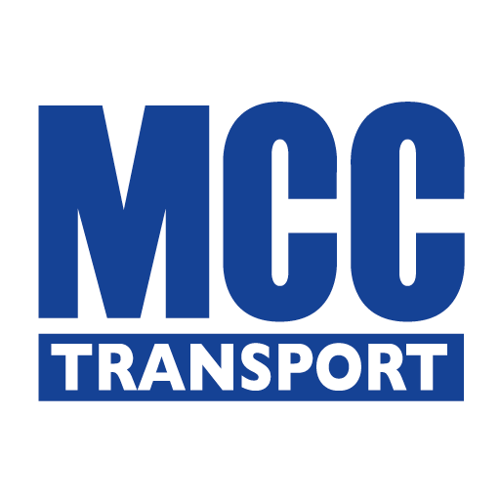



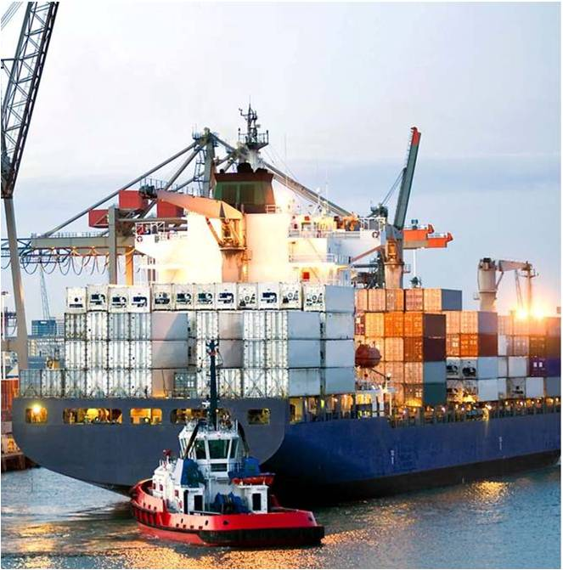
– a quick introduction
A.P. Møller – Mærsk Group
Retail
Container Shipping
Tankers, Offshore
Terminal
Oil & Gas
Retail
Technology
Lifestyle
Maersk Line
DAMCO
MCC Transport
Safmarine
Maersk Container Industry
Technology
Chemicals
A Top 10 global logistics service provider
  Established in 1977
  Headquarter in the Hague, Netherlands
  Over 10,800 employees in 100+ countries
  Over 300 offices, fully owned by Damco
  In 2012, 300 supply chain projects creating USD 140m+ savings for our customers
Industrial
Government

Slide 3
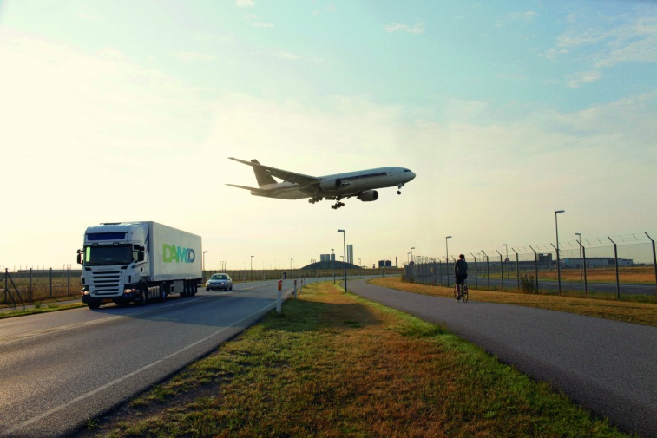
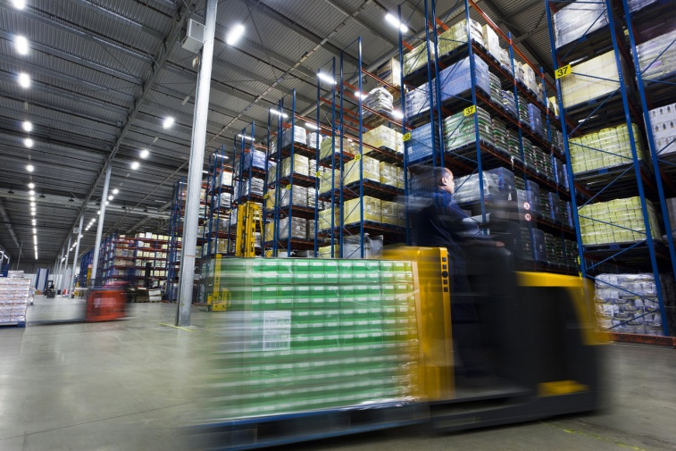
Logistics Market Overview and Trends
  Supply Chain is gaining attention within our customers’ organizations and a more holistic view of the supply chain is emerging, which drives focus on end-to-end solutions and optimization
  The increased focus on end-to-end supply chain solutions and optimization is driving a trend towards 4PL or “Lead Logistics Provider” solutions

Slide 4
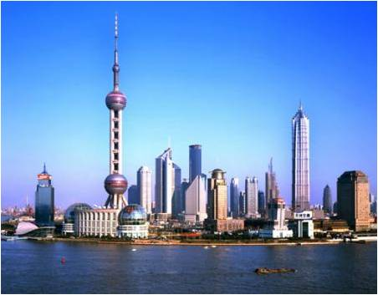
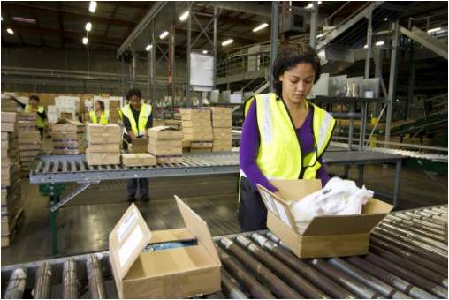
Logistics Market Overview and Trends
  Low growth in North American and European economies are driving many established brands to look for new markets in Asia and Latin America
  E-commerce is growing rapidly and is a general challenge within supply chains. Solutions are evolving in iterations

Slide 5

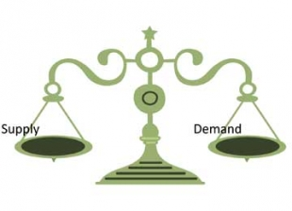
Logistics Market Overview and Trends
  Increasing Chinese labour costs and the appreciating RMB are driving a shift of sourcing towards Western China and especially Indonesia, Cambodia and likely soon Myanmar
  Changes in both sourcing and distribution networks are driving new supply chain designs such as origin based distribution centres
  Demand volatility is driving a need for more agile and dynamic supply chains

Slide 6
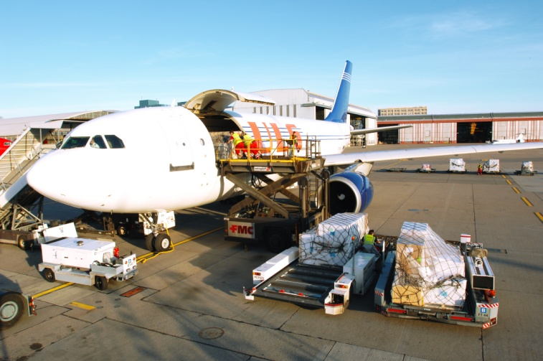
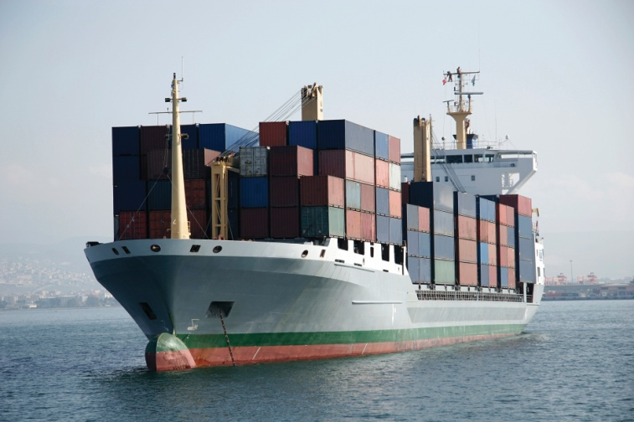
Logistics Market Overview and Trends
  Margin pressure, lower growth and environmental concerns are driving a shift away from airfreight despite increased air passenger traffic and reduced demand resulting in lower airfreight rates
  Ocean freight volatility is increasing and driving a trend towards a more diversified/balanced carrier contract mix with both short and long term contracts spread on carrier direct as well as NVO partners

Slide 7
Damco IN North Asia

Slide 8
Damco North Asia
3,194 white-collar staff
338 blue-collar staff
5 joint-venture warehouses
Offices in 25 cities
Supply chain: 34.5m CBM
Ocean freight: 350,000 TEU
Air freight: 174,000 TONs
Warehouse (operated): 350,000 m²
Quick Facts 2012
Urumqi
Beijing
Xinjiang
Dalian
Gansu
Inner Mongolia
Tianjin
Hebei
Seoul
Tokyo
`
Ningxia
Shanxi
Qingdao
Yokohama
Qinghai
Shandong
Osaka
Xi’an
Jiangsu
Busan
Henan
Nanjing
Shaanxi
An Hui
Shanghai
Tibet
Sichuan
Wuhan
Chengdu
Hubei
Zhejiang
Chongqing
Nanchang
Ningbo
Changsha
Jiangxi
Fuzhou
Legend
Guizhou
Hunan
Fujian
Taipei
Guangxi
Guangdong
Xiamen
Da-Yuan
Damco Office
Kunming
Guangzhou
Shenzhen
Kaohsiung
Gateway
Hong Kong
Warehouse
Hainan

Slide 9



Damco’s unique differentiators
Supply chain optimisation through market leading visibility solution and consultancy team
SCD +
Ease of doing business through customer focus and
consistently high service level
Reliable growth partner through
a truly global network of own offices
Notes:
Supply chain optimisation through market leading visibility solution and consultancy team
Global team of specialised supply chain consultants
Proprietary supply chain simulation tools
Detailed online track & trace plus reporting engine
e-booking platform for vendors with real time visibility
Exception Management with auto-generated alerts
Electronic platform for sharing standard operating procedures
e-portal for sharing scanned shipment documents
Ease of doing business through customer focus & constantly high service level
Dedicated customer teams covering end-to-end solutions
Energised, knowledgeable and passionate people
Scalable teams
Strong IT platform
Reliable growth partner through a truly global network of own offices
Over 10,800 employees in over 300 offices across 90 countries
Representation in a further 30 countries

Slide 10








Our Service Offerings
Vendor
CFS
DC
Store
Damco Customised End-to-end Solutions
Freight Forwarding Services
Ocean Freight
Co-loading
Air Freight
Trucking
Customs Clearance
Supply Chain Management
Purchase Order Management
Vendor Management
Consolidation
Carrier Management
Document Management
Warehousing and
Distribution
Origin DC
Regional DC
Fulfillment Center
Multi Country Consolidation
Local Distribution
Value Added Services
Quality Control
Slip Sheeting
Pick & Pack
Labeling & Scanning
Garments on Hanger
Supply Chain Development
Carbon Footprint Analysis
Center of Gravity Analysis
Load Optimisation
Packaging Consultancy
Supply Chain Benchmarking

Slide 11



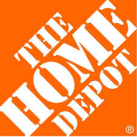
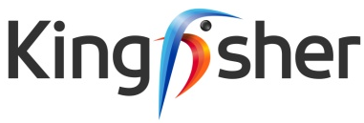





















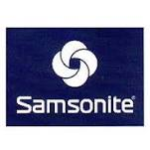


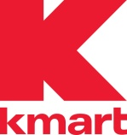


Reference Customers in North Asia

Slide 12



Slide 13
APPENDIX

Slide 14
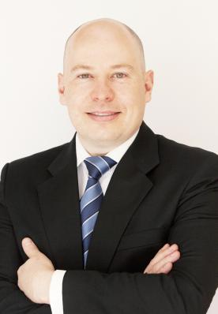
Martin Holme
Chief Operating Officer, Damco North Asia
Martin Holme has 17 years of experience in the shipping and logistics industry, which he has supplemented with a Master of Business Administration jointly awarded by the Chicago based Kellogg School of Management & Hong Kong University of Science and Technology.
Martin has spent several years working for Damco both in the global head quarters and in Mainland China, where he held positions as Head of the South China organization and later, as North Asia Head of Contract Logistics and the Joint Venture portfolio.
As COO Martin leads a Damco regional team of product and implementation specialists. Directly reporting to him are:
Head of Supply Chain Management
Head of Ocean
Head of Procurement
Head of Health, Safety, Security and Environment
Head of Implementation
Head of Legal & Compliance
Head of Project Unity
Head of Strategy and Communications
Experience
2012 – | Chief Operating Officer, Damco, North Asia | (Hong Kong)
2009-2012 | Head of Sales & Marketing, Maersk Line, South China | (Hong Kong)
2008-2009 | Head of Contract Logistics, Maersk Logistics North Asia | (Shanghai)
2006-2008 | Head of Maersk Logistics, South China | (Shenzhen)
2003-2006 | Personal Assistant to the Chairman, A.P. Moller-Maersk Group | (Copenhagen)
2002-2003 | Global Market Intelligence Manager, Maersk Logistics | (Copenhagen)
2000-2002 | HR consultant, The A.P. Moller – Maersk Group | (Copenhagen)
1998-2000 | Country Manager, Maersk Uganda Ltd. | (Kampala)
1996-1998 | Management Trainee with two job rotations | (Copenhagen)

